Slide 1
Adaptive Adaptive Indexing
Abstract:
We will develop an adaptive index, which realizes meta-adaptivity by
(1) generalizing the way reorganization is performed,
(2) reacting to the evolving indexedness and varying reorganization effort,
(3) defusing skewed distributions in the input data.

Slide 2
I. INTRODUCTION
An overwhelming amount of adaptive indexing algorithms exists today:
adaptive indexing must deal with high variance, slow convergence speed,
weak robustness against different query workloads and data distributions,
the trade-off between individual and accumulated query response time
We will present a generalized adaptive indexing algorithm that adapts itself to the characteristics of specialized methods, while outperforming them at the same time.
Generalize the way of index reﬁnement
Various types of database cracking as well as sorting can be expressed via a function partition-in-k that produces k disjoint partitions.
Adapt the reorganization effort
adjusting the partitioning fan-out k with respect to the size of the partition to work on
with a decrease in size of the input partition that has to be reﬁned, we increase the fan-out k of partition-in-k.
Identify and defuse skewed key distributions
First, we are able to detect skew in the input without overhead.
Second, in the presence of skew, we recursively split partitions that are way larger than the average to enforce a balanced processing of subsequent queries.

Slide 3
II. GENERALIZING INDEX REFINEMENT
Generalize the way of index reﬁnement
Classical approaches mostly rely on comparison-based methods
We use a radix based partitioning algorithm[11]
distinguish between the very ﬁrst query and subsequent queries
In the former case, we can use a highly optimized out-of-place radix partitioning[12]
In the latter case, we use an in-place radix partitioning algorithm[13]
When should we invest how much into partitioning?

Slide 4
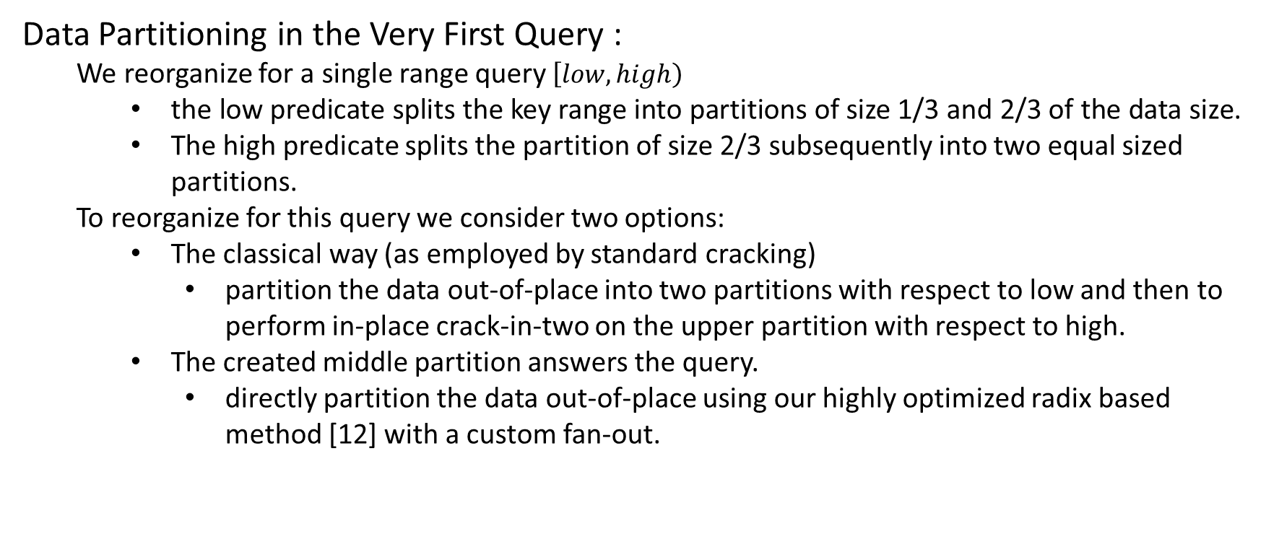
III. ADAPTING REORGANIZATION EFFORT
Data Partitioning in the Very First Query :
We reorganize for a single range query $\left[low,high\right)$
the low predicate splits the key range into partitions of size 1/3 and 2/3 of the data size.
The high predicate splits the partition of size 2/3 subsequently into two equal sized partitions.
To reorganize for this query we consider two options:
The classical way (as employed by standard cracking)
partition the data out-of-place into two partitions with respect to low and then to perform in-place crack-in-two on the upper partition with respect to high.
The created middle partition answers the query.
directly partition the data out-of-place using our highly optimized radix based method [12] with a custom fan-out.

Slide 5
III. ADAPTING REORGANIZATION EFFORT
Data Partitioning in the Very First Query :
Out-of-place Radix Partitioning
in the ﬁrst pass, we scan the input and count how many entries will go into each partition. Based on this histogram, we initialize pointers to ﬁll the partitions.
In the second pass, we perform the actually partitioning by copying the entries into the designated partitions.
quite costly:
naively copying: fan-outs larger than 32 [12]
random fashion: more than 32 partitions
To overcome this problem:
software-managed buffers

Slide 6
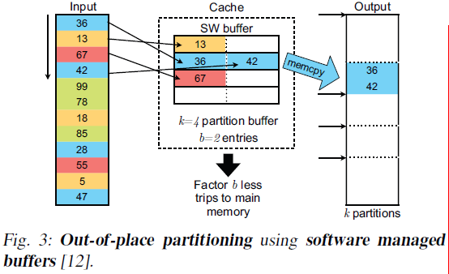
III. ADAPTING REORGANIZATION EFFORT
Data Partitioning in the Very First Query :
Out-of-place Radix Partitioning
in the ﬁrst pass, we scan the input and count how many entries will go into each partition. Based on this histogram, we initialize pointers to ﬁll the partitions.
In the second pass, we perform the actually partitioning by copying the entries into the designated partitions.
quite costly:
naively copying: fan-outs larger than 32 [12]
random fashion: more than 32 partitions
To overcome this problem:
software-managed buffers

Slide 7
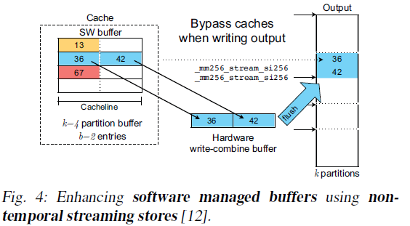
III. ADAPTING REORGANIZATION EFFORT
Data Partitioning in the Very First Query :
Out-of-place Radix Partitioning
in the ﬁrst pass, we scan the input and count how many entries will go into each partition. Based on this histogram, we initialize pointers to ﬁll the partitions.
In the second pass, we perform the actually partitioning by copying the entries into the designated partitions.
quite costly:
naively copying: fan-outs larger than 32 [12]
random fashion: more than 32 partitions
To overcome this problem:
software-managed buffers
non-temporal streaming stores

Slide 8
III. ADAPTING REORGANIZATION EFFORT
Data Partitioning in Subsequent Queries :
In-place Radix Partitioning :
a histogram generation phase.
we scan partition p0 from the beginning and identify the ﬁrst entry x that does not belong to partition p0, but actually to another partition, let’s say p5.
Then, we scan partition p5 until we ﬁnd the ﬁrst entry y that does not belong to p5.
Evaluation :
the strategy for the very ﬁrst query: Create a signiﬁcantly larger number of partitions than standard cracking(creating only three partitions) with negligible overhead and consequently reduce the average partition size drastically.
adapt the partitioning fan-out k during the query sequence: With a decrease in partition size, increase the fan-out k. At a sufﬁciently small size, ﬁnish the partition by sorting it as the cost is negligible.

Slide 9
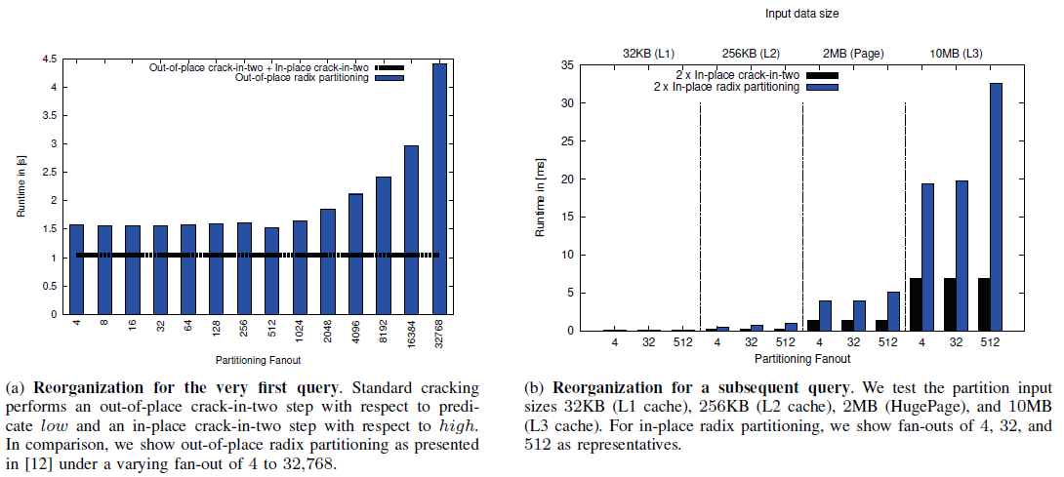
III. ADAPTING REORGANIZATION EFFORT
Evaluation :

Slide 10
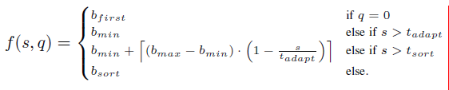
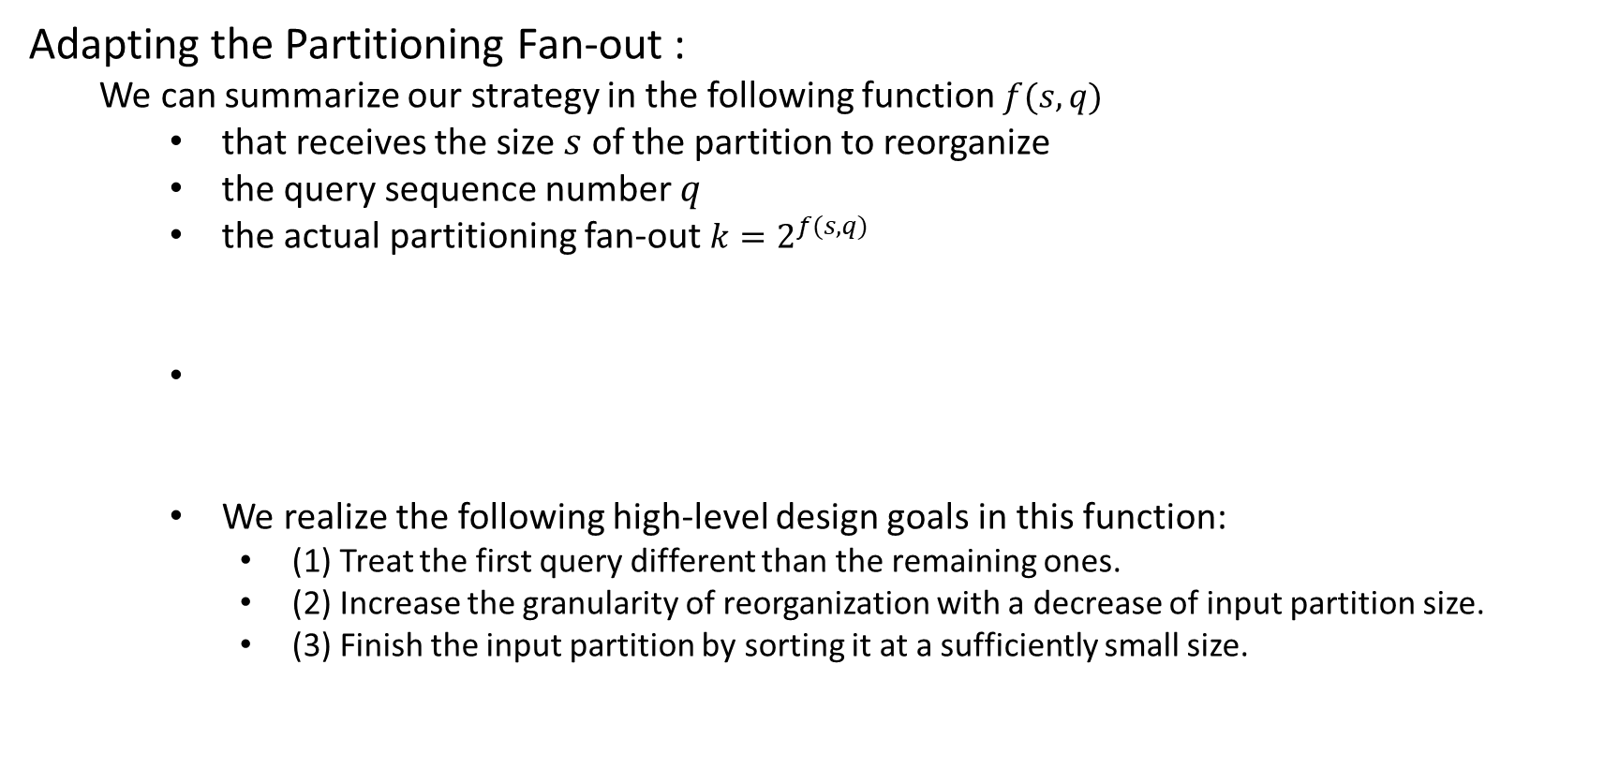
III. ADAPTING REORGANIZATION EFFORT
Adapting the Partitioning Fan-out :
We can summarize our strategy in the following function $f(s,q)$
that receives the size $s$ of the partition to reorganize
the query sequence number $q$
the actual partitioning fan-out $k=2^{f(s,q)}$
We realize the following high-level design goals in this function:
(1) Treat the first query different than the remaining ones.
(2) Increase the granularity of reorganization with a decrease of input partition size.
(3) Finish the input partition by sorting it at a sufficiently small size.

Slide 11
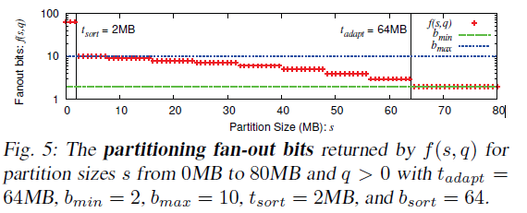

III. ADAPTING REORGANIZATION EFFORT
Adapting the Partitioning Fan-out :
We can summarize our strategy in the following function $f(s,q)$

Slide 12
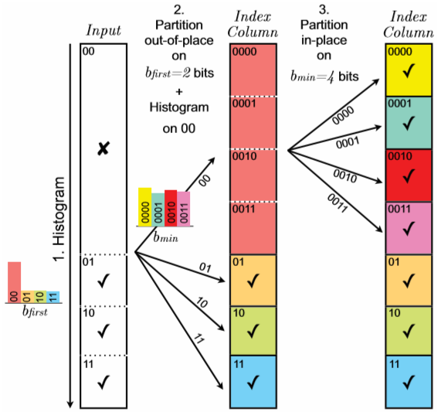
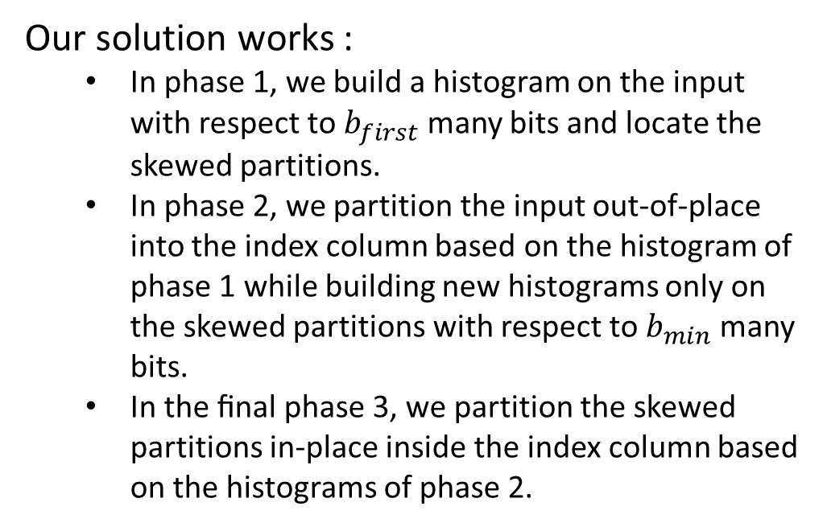
IV. HANDLING SKEW
Our solution works :
In phase 1, we build a histogram on the input with respect to $b_{first}$ many bits and locate the skewed partitions.
In phase 2, we partition the input out-of-place into the index column based on the histogram of phase 1 while building new histograms only on the skewed partitions with respect to $b_{min}$ many bits.
In the ﬁnal phase 3, we partition the skewed partitions in-place inside the index column based on the histograms of phase 2.

Slide 13
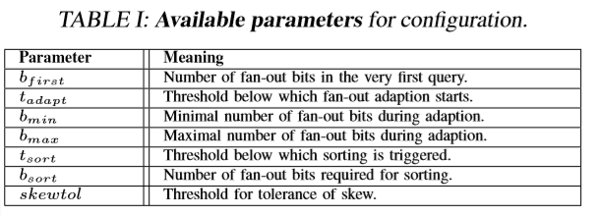
V. CONFIGURATION KNOBS
We introduced a set of parameters that allow us to tweak the conﬁguration of the algorithm towards the priorities of the user, the capabilities of the system, and the characteristics of existing adaptive indexes.

Slide 14
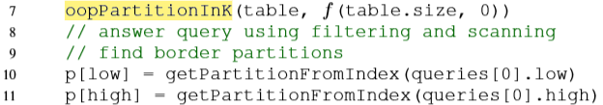
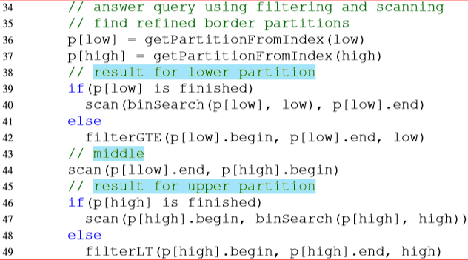
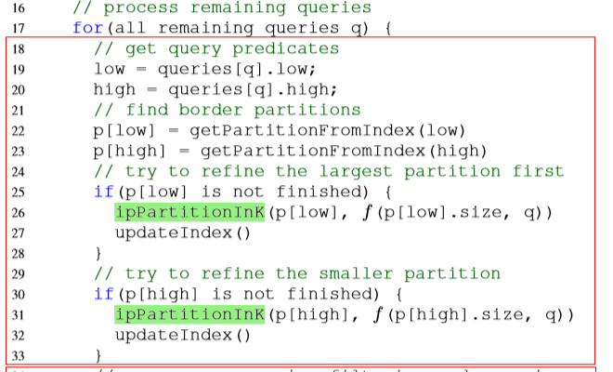
VI. META-ADAPTIVE INDEX

Slide 15
VII. BACKGROUND AND BASELINES
Standard Cracking [3]: Figure 7(a)
It offers the cheapest upfront initialization and performs the least amount of reorganization per query to answer it using a scan.
Stochastic Cracking [6]: Figure 7(b)
aims at solving sequential query patterns
we will use DD1R as the baseline, which introduces one random crack per query
Hybrid Cracking [5]: Figure 7(c)
aims at improving the convergence speed towards the fully sorted state
we will inspect the most prominent forms called hybrid crack sort (HCS) and hybrid sort sort (HSS)
Sort + Binary Search Figure 7(d) and Scan Figure 7(e)

Slide 16
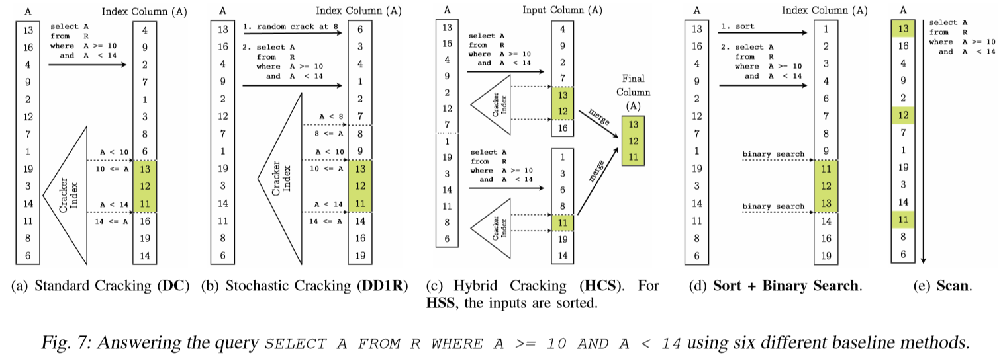
VII. BACKGROUND AND BASELINES

Slide 17
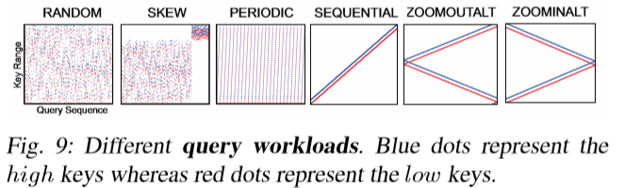
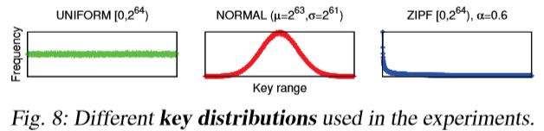
VIII. EXPERIMENTAL EVALUATION
We use three characteristic key distributions in our tests :
a uniform distribution,
a normal distribution,
a (modiﬁed) Zipf distribution
The query workload we use in the experiments.
1000 range queries
we use the workload patterns that have been described in [4] in detail
We use a ﬁxed selectivity of 1% as common in the literature [1]

Slide 18
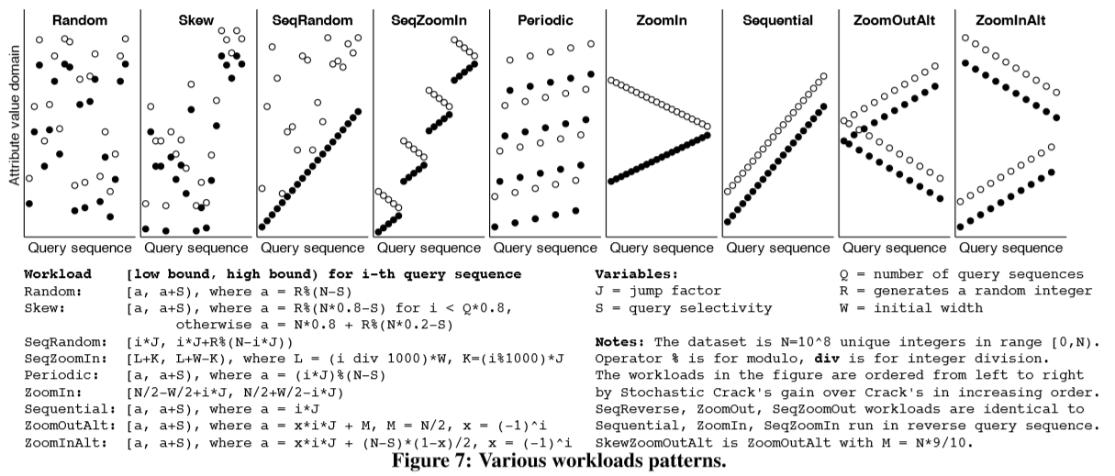
VIII. EXPERIMENTAL EVALUATION
We use the workload patterns that have been described in [4] in detail

Slide 19
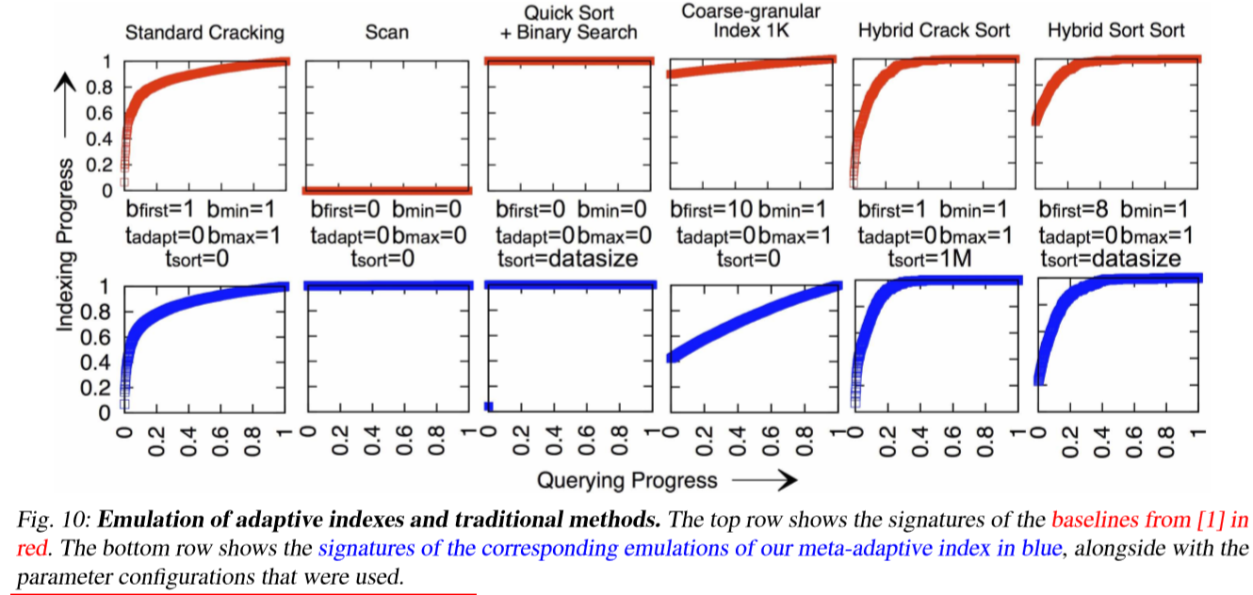
VIII. EXPERIMENTAL EVALUATION
Emulation of Adaptive Indexes :
Let us now ﬁrst see whether the meta-adaptive index is capable of generalizing the principle of adaptive indexing.

Slide 20
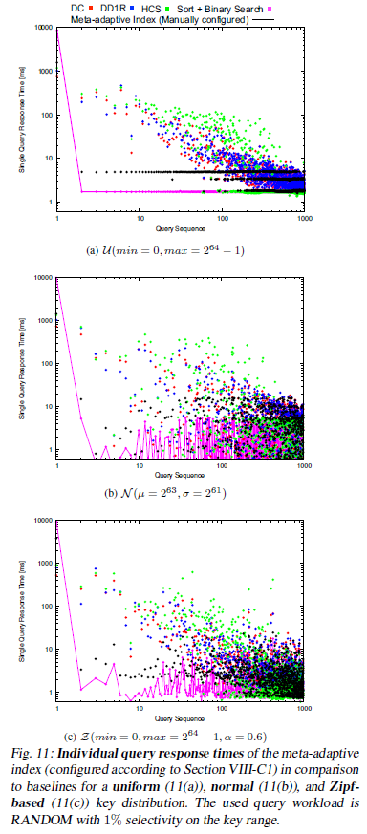
VIII. EXPERIMENTAL EVALUATION
Individual Query Response Time :
we use $b_{first}$ = 10bits, $b_{min}$ =3, $b_{max}$ =6, $t_{adapt}$ = 64MB, $t_{sort}$ = 256KB

Slide 21
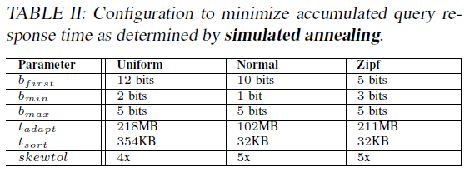
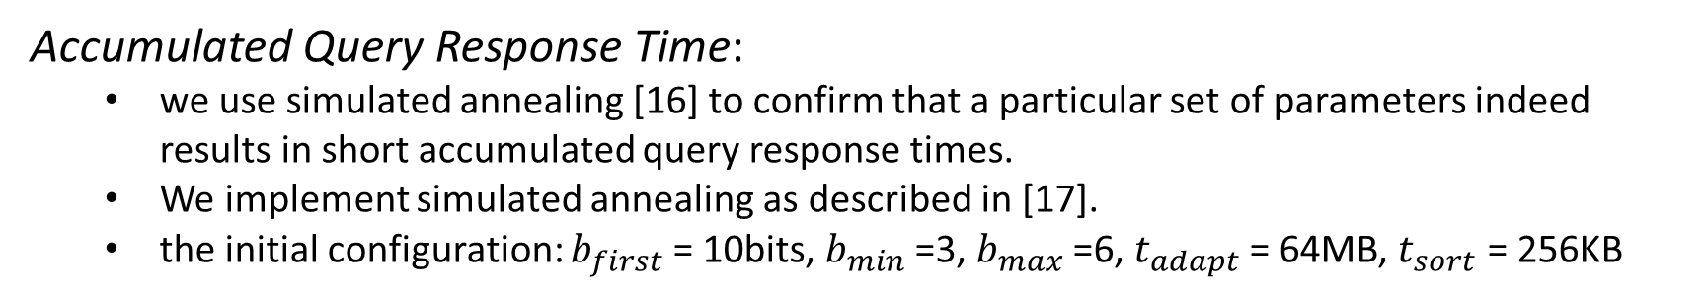
VIII. EXPERIMENTAL EVALUATION
Accumulated Query Response Time:
we use simulated annealing [16] to confirm that a particular set of parameters indeed results in short accumulated query response times.
We implement simulated annealing as described in [17].
the initial configuration: $b_{first}$ = 10bits, $b_{min}$ =3, $b_{max}$ =6, $t_{adapt}$ = 64MB, $t_{sort}$ = 256KB

Slide 22
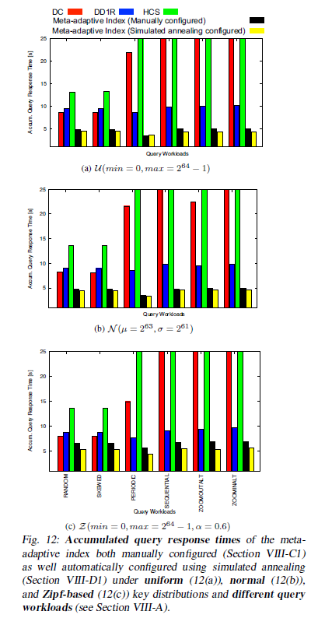
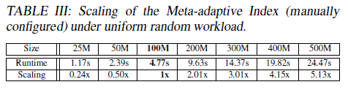
VIII. EXPERIMENTAL EVALUATION
Accumulated Query Response Time:

Slide 23
IX. CONCLUSION
Our initial goal of the meta-adaptive index was to develop a technique which can fulﬁll several of the core needs of adaptive indexing at once :
We wanted to unify the large amount of specialized adaptive indexes
We looked at how the meta-adaptive index compares with respect to the classical adaptive indexing baselines
We looked at how to manually and automatically conﬁgure the meta-adaptive index

